Slide 1

CSCI205
Final Project
Solar System Simulator
by Gabe Gomez, Zach Brill, John Venditti, and Tyler DiBartolo

Slide 2

Our Purpose
We didn’t want to make a game per se; rather, we wanted to make an interactive application that could be both graphically complex and educational in some regards.
We all liked the idea of working on a project that would be very math-oriented, where the significant part of the tasks required would be related to coding the model being represented - and not focused necessarily on data parsing or artificial intelligence.
With the above points in mind, we decided on a Solar System Simulator (SSS).

Slide 3
Some Background Information
For our project, we have been creating an orbital simulator based off of the planets within our own solar system.
Terms associated with project :
Period : How long a planet takes to revolve around the sun in Earth years
Semi-Minor Axis : Shortest radius of the ellipse in AU (Astronomical Units), but kilometer representation is put into constructor.
Semi-Major Axis : Longest radius of the ellipse and the average distance from the sun in AU, but kilometer representation is put into constructor
Eccentricity : How ovular an ellipse is. If 0, ellipse is a circle. If between 0 and 1, elliptical. If equal to 1, then it is a parabolic escape orbit. If greater than 1, then it has a hyperbolic orbit. (Unitless)
Planet radius : the radius of a planet in kilometers
Mass : Amount of matter within the planet in kilograms
Apoapsis : Planet’s farthest distance from the sun in units similar to semi-minor/major axis
Periapsis : Planets’ closest distance from the sun in units similar to above

Slide 4

Initial Challenges and
Project Importance/Motivation :
From the start, we knew that the majority of our work would lie in adapting physics formulas to work with algorithms that take care of:
determining orbit patterns,
executing single planet movement,
carrying out synchronous movement of multiple planets,
and handling scaling and viewpoint control.
We believe this to be an important project:
A). because science education is lacking within the US and our project might be utilized to help this problem.
B). because many real world projects involve the computerized modeling of complex real world scenarios; this one is complex enough to challenge us, but simple enough to fit the project’s time constraints.

Slide 5

Major Classes Implemented
Planet class :
The representation for planets created. From here, all of the relevant calculations for the planet are done, it’s path is created, wrapper image can be set and where sphere object representing the planet is
Algorithms class :
A utility class that has all of the methods in order to calculate any information for a planet that needs to be done. Also creates the path for the planet in question
Solar System class :
A class that holds all of the planets within the solar system that we create. Also has the method that sets all of the planets and their path to the root that they will be displayed upon.

Slide 6
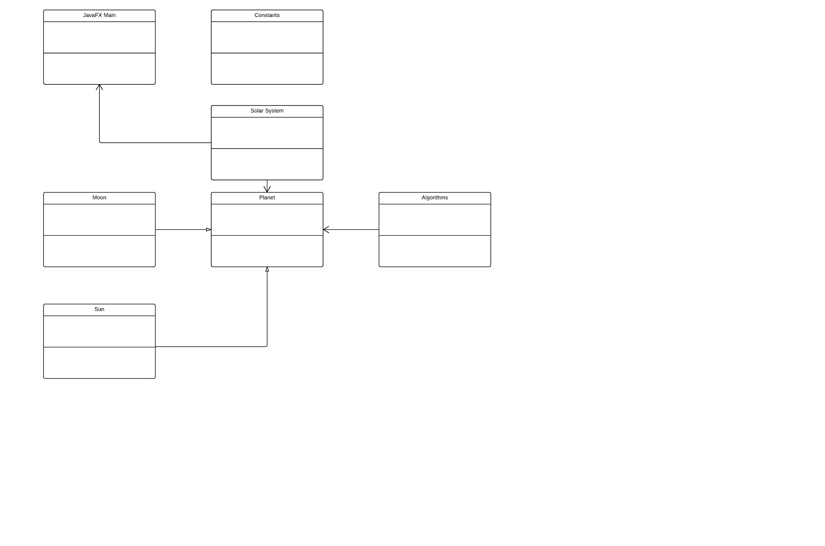

UML Diagram

Slide 7
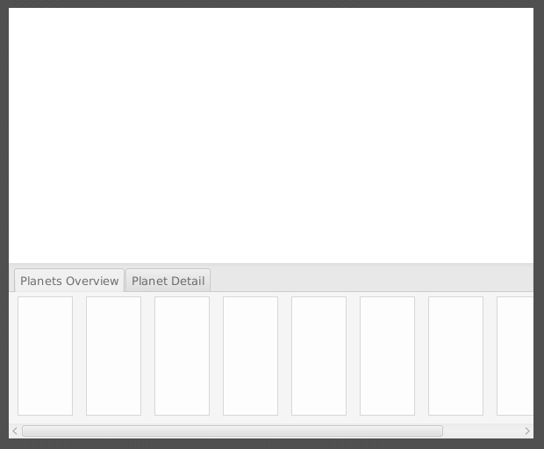

GUI
Simulation goes here.
In the “Planets Overview” tab, we plan to display some basic data points for every planet, such as:
Planet Name
Radius
Period
Mass

Slide 8
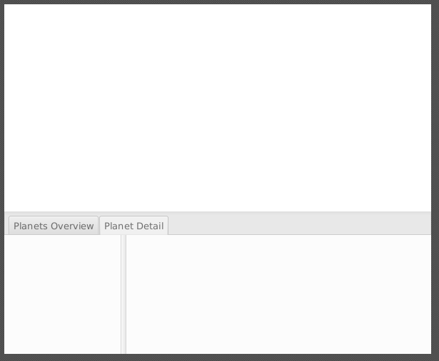
GUI
Simulation goes here.
In the “Planet Detail” tab, the left panel will have a list of all the planets.
The user will be able to select one of these planets for further inspection, at which point the right pane will populate with all the data points for that planet. A pop-up window will appear containing the selected planet, allowing the user to visually examine the planet at a closer vantage point.

Slide 9

Scrum Experience
Some of our Key User Stories :
Base Solar System Creation
Within this user story, we create much of the calculations and object representation of planets. This gave way to the creation of the JavaFX GUI Creation user story since it uses calculations that were done for a planet, and much more .
JavaFX GUI Creation
A user story associated with the creation of our GUI. One of the most important pieces associated with the project because it puts all our calculated information to display with relative size.
Strengths :
Scrum allowed us to plan the bulk of our project before a single line of code was written. This enabled us to be more productive, with a more focused goal. With Scrum, we were better able to manage our time.
Weakness :
As a team, we did not have enough scrum meetings. This led to different understandings of what had been done at different times. This is an area we can improve on for next time.

Slide 10
Things to Add in Version 2.0
Ability to add moons to planet
Give planets the moons that they have revolving around them and the paths that they would have while revolving around the planets
More of a physics simulator feel
Let the user decide on most of the aspects of the model’s state (ie. the gravitational constant, other physical constants)
Ability to create a solar system model
Give the user the option to create their own solar system model with their own created planets, proper information, and user chosen planet locations and paths

Slide 11

Resources and Links
Background Photo: http://i.imgur.com/PgYKaSd.jpg
Formulas and Algorithms (Concise):
http://stackoverflow.com/questions/14171856/javafx-2-circle-path-for-animation
http://hyperphysics.phy-astr.gsu.edu/hbase/kepler.html
http://www.softschools.com/math/calculus/writing_the_equation_of_an_ellipse/
(Note: Full list of external references can be found in UsefulEquations.txt)

